Slide 1
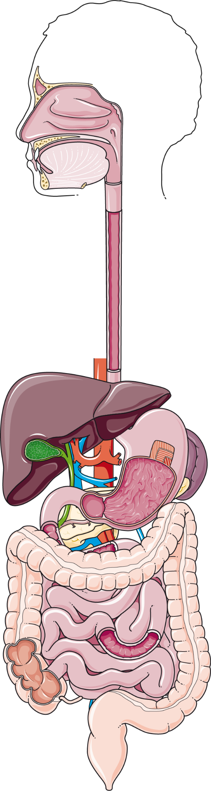
Medical Image Segmentation on 12 Abdominal Organs
Deep Learning for Visual Recognition
Goh Yun Si
Qiu Xianyan
Xiong Yu
Zin Zin Kyaw Sint
Notes:
Good afternoon everyone, we are Team 8.

Slide 2
Table of contents
01
03
02
04
Introduction
Model 2: Total Segmentator
Evaluation
Model 1: SAMed
Notes:
This is the flow of our presentation today.

Slide 3
Introduction
01
Notes:
I’ll first give an introduction or recap of the project requirements.

Slide 4
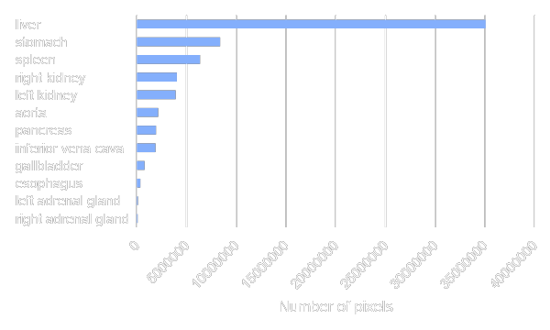
Introduction
Task
Semantic segmentation
12 organs
Training set: Imbalance classes
Dataset description
2D CT images (512x512)
Grayscale range = [0,255]
Voxel value range = [−3024, 3095]
Spacing
Bounding box
Notes:
This project is a semantic segmentation problem for 12 abdominal organs.
We were provided with CT images that has been preprocessed into 2D grayscale slices.
Some useful information given includes:
Voxel value range, used to convert the images back to CT range in Houndsfield Units
Spacing, used to create 3D volumes and calculate Normalized Surface Dice
And bounding box, used to suppress background
The data we were given has been split into train/valid/test
From the training set, we noticed that the classes are highly imbalance, either due to organ size or frequency, which we will have to address during training later on.

Slide 5
General Pipeline
SAMed
TotalSegmentator (TS)
Rescale to [0,1]
Light augmentation
Rotate, rescale, noise, blur, jitter, gamma
Compute weights (class & sample)
For weighted loss or sampling
Convert to CT range (HU)
Stack 3D images and labels
Automated processing
Resample, normalize, crop
Based on image spacing, intensity, class distributions
Pre
Transfer pretrained weights
Staged training: start with decoder and later, unfreeze all layers
Transfer pretrained weights
Automated processing
Cross-validation & ensemble
Train
Post
Use bbox to set background
Future work: crop organs before prediction
Notes:
Our group tested 2 models: SAMed as baseline, and TS, one of the most comprehensive medical segmentation model.
We prepared the data for SAMed by rescaling the images to the required range.
As medical images are not as varied as images like the birds in our assignment, we kept data augmentation light and realistic.
We also computed class and sample weights in an attempt to address class imbalance. Initial testing of weighted sampling showed that it did not help with minority classes, so we didn’t implement it in the end.
For training, we transferred the pretrained weights for existing organs.
We also tried to do a staged training, but it made the results worse so we got rid of it.
As TS is pretrained on 3D CT and MRI images, we converted the images back to CT range and stacked them into 3D volumes.
We did not have to worry about augmentation as this model automatically preprocess the data based on the dataset statistics.
For training, again, we transferred the pretrained weights.
And let the model automatically handle class imbalance via cross-validation & ensembling
Finally, we post-process the outputs from both models by setting the areas outside bbox as 0..
For future work, we can also try to crop the images before prediction.

Slide 6
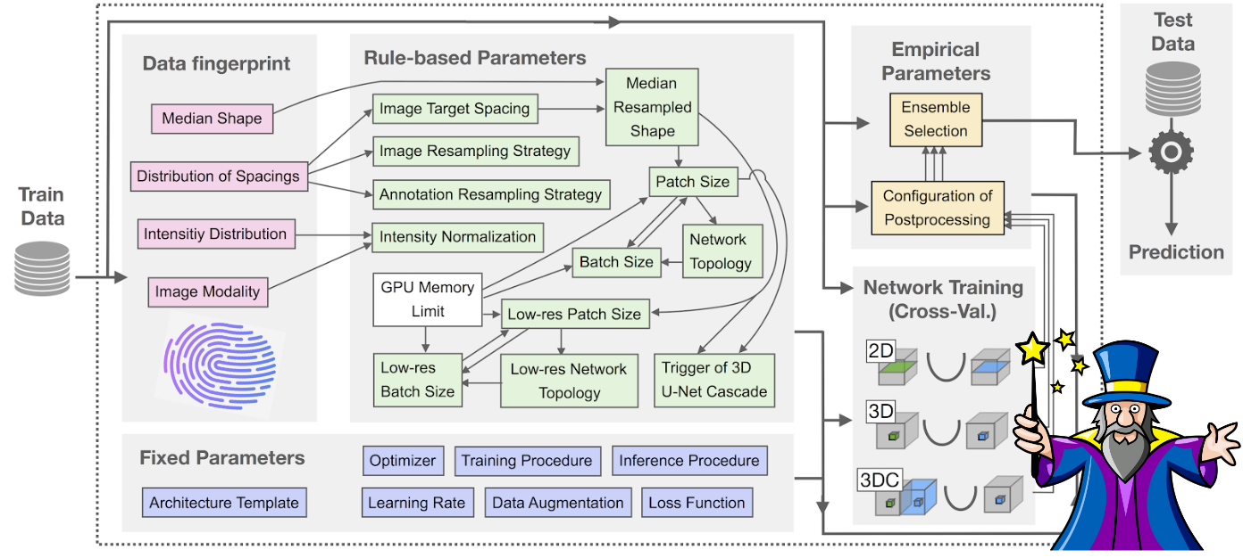
Automated Processing
https://github.com/MIC-DKFZ/nnUNet?tab=readme-ov-file
Notes:
This is the automated processing for Total Segmentator which handles augmentation, cross validation and ensembling. We didn’t examine the details as it worked well without any modifications. But tweaking this could be a future work for further improvements.

Slide 7
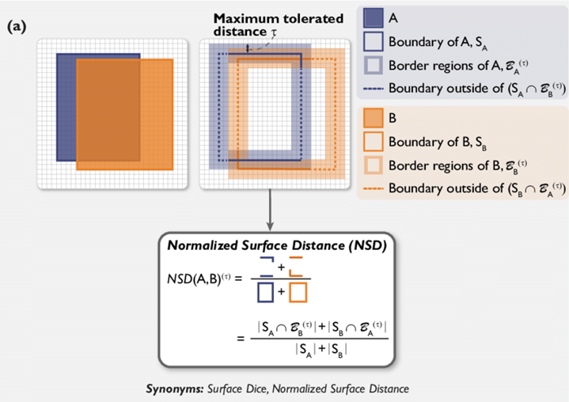
Evaluation Metrics
2|A ∩ B|
2TP
DSC =
=
|A| + |B|
2TP + FP + FN
TN
Metrics | Use Case | Imbalance | Background | Boundary
Pixel accuracy | Standard | No | No | No
Mean accuracy | Standard | Yes | No | No
Mean IoU | Standard | Yes | No | No
Dice Similarity Coefficient (DSC) | Medical | Yes | Yes | No
Normalized Surface Dice (NSD) | Medical | Yes | Yes | Yes
FN
TP
FP
tolerance = 1mm
Notes:
For semantic segmentation, the common evaluation metrics are pixel accuracy, mean accuracy, and mean IoU, which I will not go through as they have already been taught in class.
However, they are not suitable for medical images as they do not account for background dominance and boundary precision requirements.
For our evaluation, we will use DSC and NSD, as they are the competition metrics, and are more commonly used in medical domain.
DSC is suitable for background-dominated medical images as it excludes true negatives in its calculations.
And NSD is specially designed to calculate the surface boundary precision within a tolerance distance.

Slide 8
Model 1: SAMed
02

Slide 9
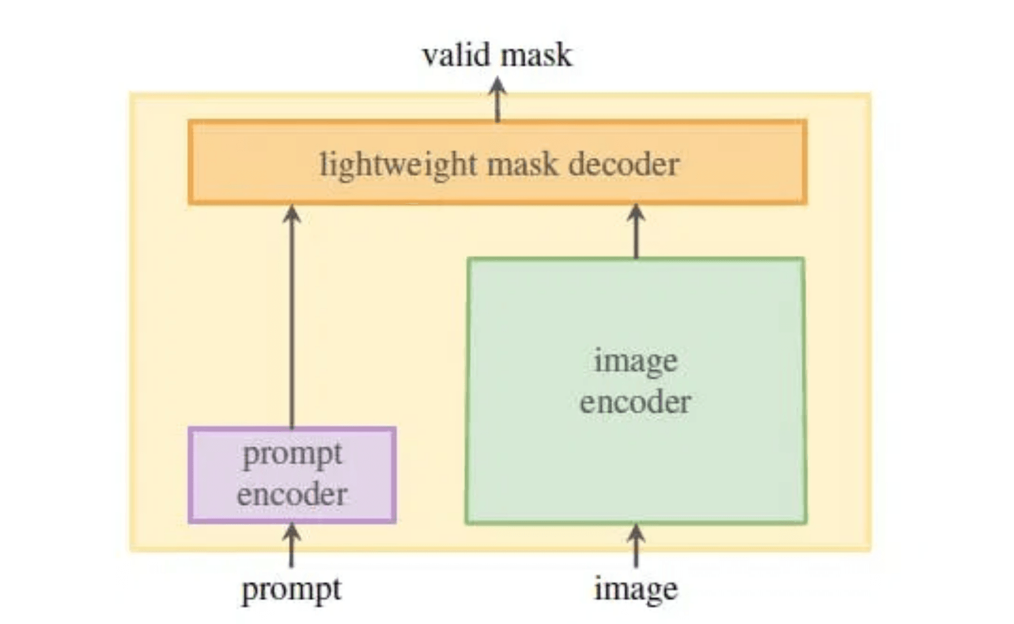
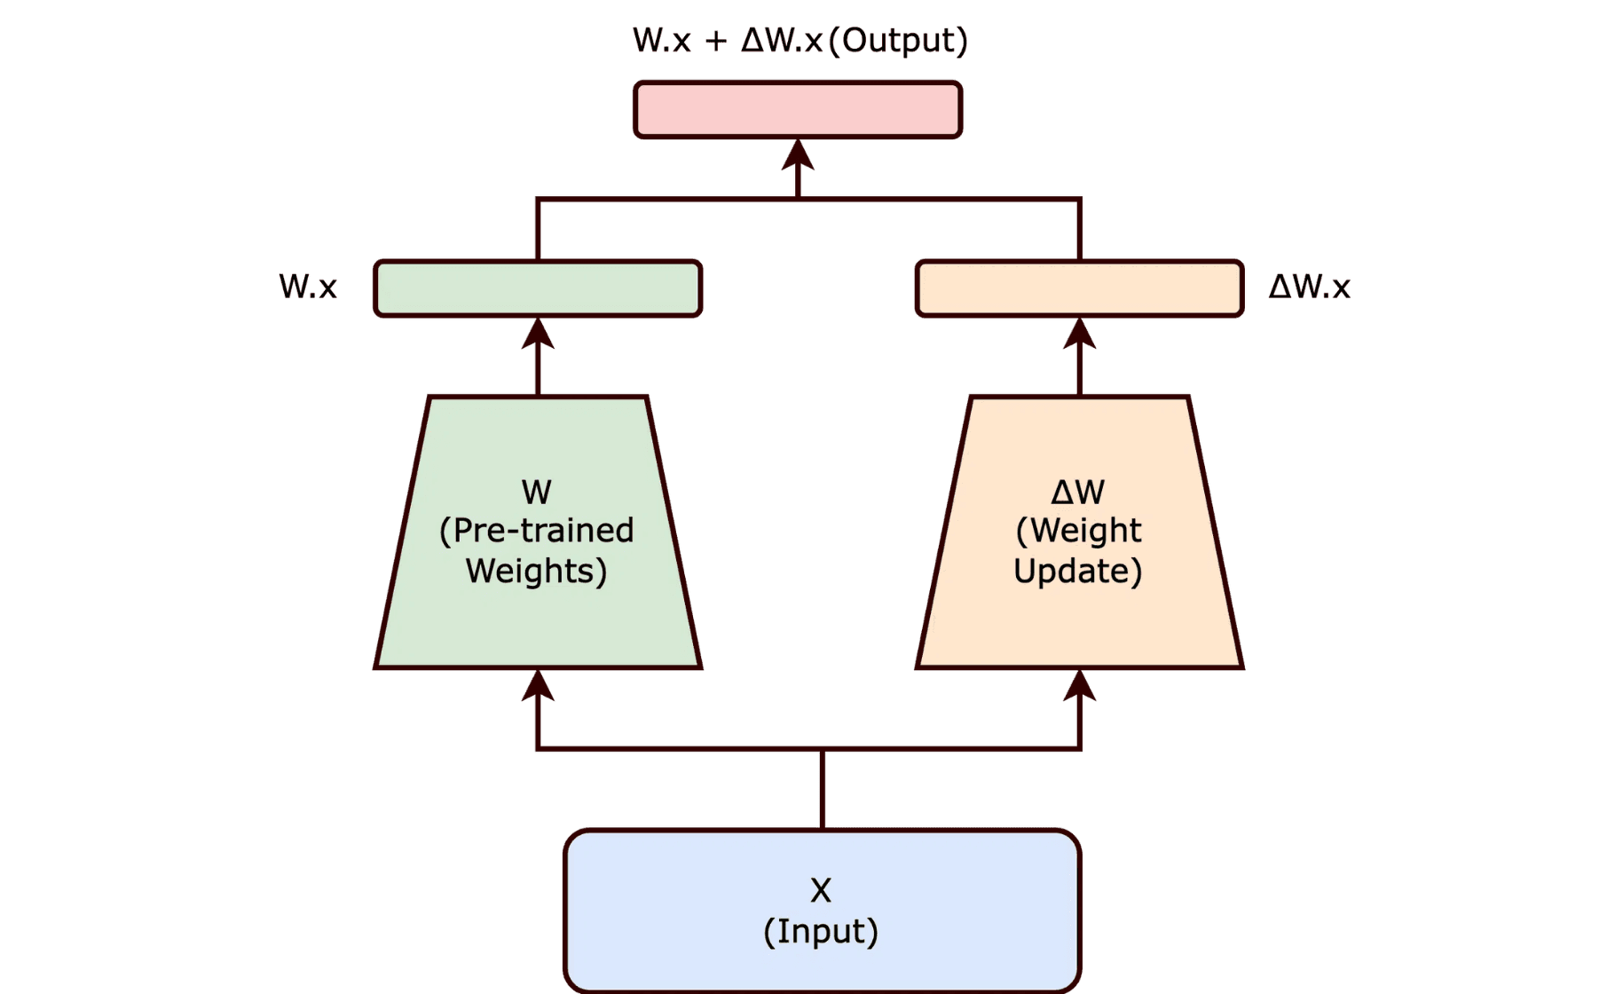
SAMed: SAM + LoRA
Medical Image Segmentation with Foundation Models
SAM Architecture
LoRA Fine-tuning
Segment Anything Model:
Low-Rank Adaptation:
Foundation model with image encoder, prompt encoder, and lightweight mask decoder
Efficient fine-tuning by training lightweight layers while freezing pretrained weights
Notes:
SAM : image encoder, prompt encoder, and lightweight mask decoder
LORA: can allow us Efficient fine-tuning by training lightweight layers while freezing pretrained weights

Slide 10
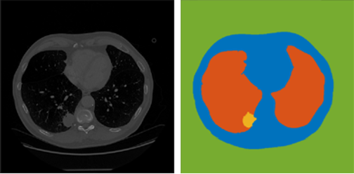
2D Pipeline and Training Strategy
Pre-processing Pipeline: 2D Approach Handles 2D CT slices at 512×512 resolution with rescaling to [0, 1] range. Data augmentation applies medical-appropriate transformations
Loss Function Strategy Addresses class imbalance with hybrid loss function combining Weighted Cross Entropy (inverse frequency weights) and Dice Loss.
Loss = (1 - α) × Weighted CE + α × Dice Loss
Transfer Learning Approach
Transferred pre-trained weights for 8 existing organ classes, initialized 4 new classes as 0, fine-tuned using LoRA layers while keeping encoder frozen.
Notes:
some organs are very small + dataset is strong class imbalanced,
👉loss function : weighted CE + Dice Loss
Weighted CE helps the model pay more attention to rare, small organs,
while Dice Loss helps us to get a consistent shape and boundary.
Finally, we use transfer learning:
Transferred pre-trained weights for 8 existing organ classes, initialized 4 new classes

Slide 11
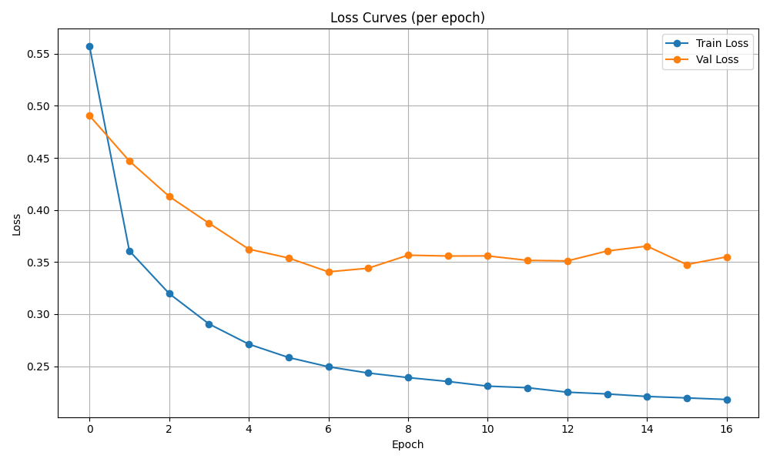
Experimental Results and Training Configurations
Parameter
Run1 ★
Run2
Run3
Run4
Loss Type
Weighted CE + Dice
CE + Dice
Weighted CE + Dice
CE + Dice
Dice Weight
0.4
0.8
0.8
0.8
Max Epochs
20
80
80
80
Best Epoch
6
1
21
60
Best Configuration: Run1
Training Loss Convergence
Run1 achieved the best performance using Weighted CE + Dice (0.4 weight), emphasizing weighted cross entropy at 60% to address class imbalance. The model showed early convergence at epoch 6, indicating efficient learning without overfitting.
Key Insights
Weighted loss functions are essential for handling small organ segmentation in imbalanced medical datasets. Early stopping prevents overfitting while maintaining generalization. The weighting strategy in Run1 significantly outperforms more balanced approaches.
Notes:
epoch 6
learned efficiently without overfitting.
Get Key Point : Using [weighted loss ]is crucial for small organ segmentation in imbalanced datasets.

Slide 12
Analysis and Limitations
Organ | DSC | NSD
Liver (large) | 0.8847 | 0.7863
Stomach (large) | 0.7656 | 0.6509
Spleen | 0.8099 | 0.7116
Right Kidney | 0.7341 | 0.6113
Left Kidney | 0.7133 | 0.5884
Aorta | 0.8472 | 0.7761
Pancreas (irregular) | 0.5434 | 0.5022
Inferior Vena Cava* | 0.6108 | 0.5199
Gallbladder | 0.4702 | 0.4536
Esophagus* | 0.5499 | 0.5328
Left Adrenal Gland* (irregular) | 0.2190 | 0.2757
Right Adrenal Gland* | 0.1951 | 0.2598
Performance Highlights (Run1)
Strong on Large Organs: Liver, stomach, spleen, and kidneys achieved high DSC scores with consistent accuracy.
Tubular Structures: Aorta well-captured due to consistent geometry across slices.
Model Advantages: Fast domain adaptation with foundation model, high computational efficiency via LoRA, strong generalization on common anatomical structures.
Key Limitations
Poor on Small Organs: Pancreas, esophagus, and adrenal glands show significantly lower DSC and NSD scores due to sparse pixels and irregular shapes.
Boundary Precision Gap: NSD scores generally lower than DSC, indicating room for improvement in edge accuracy.
Future Improvements: Explore targeted sampling for small organs, fine-tune LoRA rank parameters, consider 3D context integration.
Table is arranged by descending number of pixels in training set
Notes:
well in large organs : liver, stomach, spleen, and kidneys.
not very well in small and inrregular shaped organs : such as the pancreas and adrenal glands.
These small organs have fewer pixels, and their boundaries are more complex
DSC and NSD lower, NSD<DSC
“So overall, SAMed provides a fast and efficient adaptation of a foundation model to medical segmentation.
but still needs improvement for small organs and boundary accuracy, which motivates our use of a 3D approach in the next model.

Slide 13
Model 2: Total Segmentator
03

Slide 14
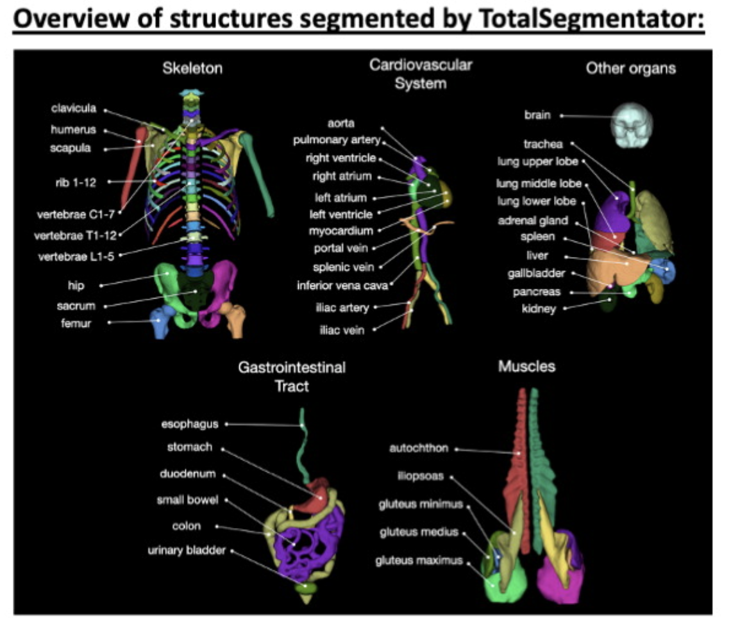
Total Segmentator (nnU-Net)
nnU-Net | Total Segmentator
U-Net variant for automated biomedical image segmentation Skip connections connect encoder to decoder to capture fine details Fully self-configuring framework: Preprocessing Architecture setup Training and postprocessing Achieves near-optimal performance with minimal manual tuning Backbone of TotalSegmentator’s segmentation accuracy | Built on nnU-Net as a whole-body CT segmentation foundation model Pretrained on thousands of CT scans (104 anatomical structures) Strong generalization across: Organs and tissues Scanners and imaging protocols Native 3D understanding → superior spatial context vs. 2D models
Notes:
https://github.com/wasserth/TotalSegmentator
https://github.com/MIC-DKFZ/nnUNet?tab=readme-ov-file
What is nnU-Net?
U-Net variant architecture
nnU-Net (v2) is a fully automated semantic segmentation that automatically configures preprocessing, architecture, training, and postprocessing for a given dataset (biomedical domain), ensuring near-optimal segmentation performance with minimal manual tuning. It’s a proven, high-performing architecture for medical image segmentation and forms the backbone of TotalSegmentator’s robustness and accuracy.
Why Total Segmentator?
Built on top of nnU-Net, TotalSegmentator is a robust, domain-specific foundation model for whole-body CT segmentation. It has been pretrained on thousands of CT scans across >100 anatomical structures, giving it strong generalization to diverse organs, scanners, and protocols. As a medical-domain model, it captures volumetric context (3D) natively, unlike 2D vision foundation models.
Disadvantages: Limited generalizability to specific populations as model is trained on adult data set and there is variability with organ size and age.

Slide 15
nnU-net vs Total Segmentator
 | nnU-net | Total Segmentator
Core design | Auto adapts to dataset | Built on nnU-net, 3D, multi-organ
Strength | Consistent, high accuracy | Robust for many structures
Weakness | Needs tuning for rare cases | Lower accuracy for smaller organs

Slide 16
Training Configurations
Training Setup
Transferred weights (all 12 classes)
Loss: 50% Cross-entropy + 50% Soft Dice (continuous probabilities for stable gradients)
Deep supervision: Intermediate decoder losses weighted exponentially for stability and feature learning
Testing Pipeline
Low-res 3D model (5-fold) captures global structure efficiently
One high-res fold refines local details
Ensembled outputs deliver optimal segmentation
Balanced pipeline combining low/high-res stages for speed, resource efficiency, and accuracy
Notes:
Transferred weights for all 12 classes
Loss: Combination of 50% Cross-entropy + 50% soft Dice loss (uses continuous probabilities for more stable gradient)
Deep supervision: Losses from intermediate decoder outputs also considered, each weighted exponentially which improves training stability and feature learning.
Multi-step testing:
Low-resolution 3D model captures global structure, runs in 5-fold setting for robustness and efficiency.
One high resolution fold to refine local details
Outputs from both are ensembled for optimal segmentation
Pipeline balances speed, resource use, and accuracy by combining low/high res outputs, with deep supervision ensuring richer, more reliable training.

Slide 17
Ensemble and U-Net Cascade approach
This method combines model ensembling with a two-stage U-Net cascade for robust 3D image segmentation.​
Ensemble Averaging
Multiple models produce softmax probability maps; these are averaged voxel-wise for each class.
The final segmentation assigns each voxel to the class with the highest average probability.
Two-Stage Cascade
Stage 1: A low-resolution U-Net segments the coarse structure from a downsampled image.
Stage 2: A full-resolution U-Net refines this using both the original image and the upsampled coarse map, achieving high accuracy.
This approach ensures both robustness (ensemble) and fine detail (cascade) in medical image segmentation.​

Slide 18
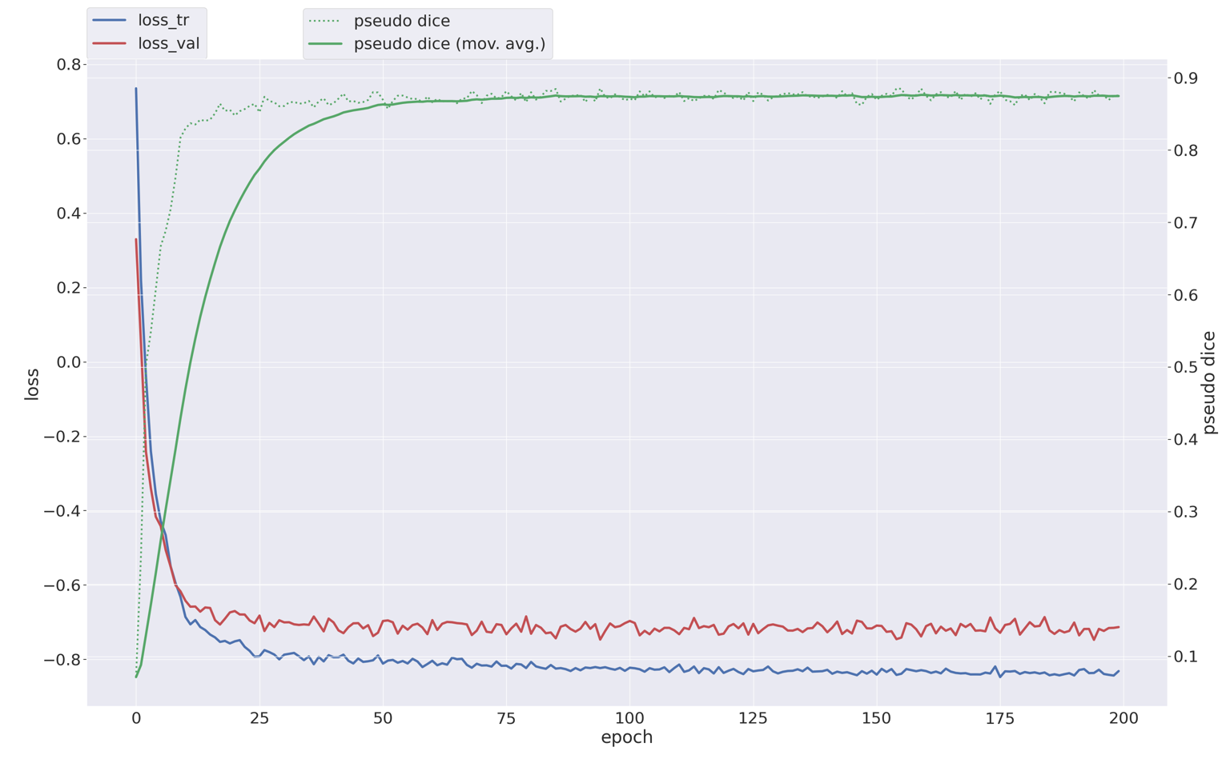
Best Training (3D lowres fold 2)
Organ | DSC | NSD
Liver | 0.9724 | 0.9703
Stomach | 0.9328 | 0.9336
Spleen | 0.9544 | 0.9638
Right Kidney | 0.9199 | 0.9245
Left Kidney | 0.9095 | 0.9283
Aorta | 0.9478 | 0.9568
Pancreas | 0.7772 | 0.7806
Inferior Vena Cava | 0.8953 | 0.8851
Gallbladder | 0.7701 | 0.8220
Esophagus | 0.8221 | 0.8585
Left Adrenal Gland | 0.7603 | 0.8723
Right Adrenal Gland | 0.7133 | 0.8442
More balanced than SAMed, although smaller organs / rare classes still performed slightly worse
Table is arranged by descending number of pixels in training set
Notes:
smaller organs:esophagus and adrenal glands
Improvement in NSD and DSC, managed to address and improve the edge accuracy

Slide 19
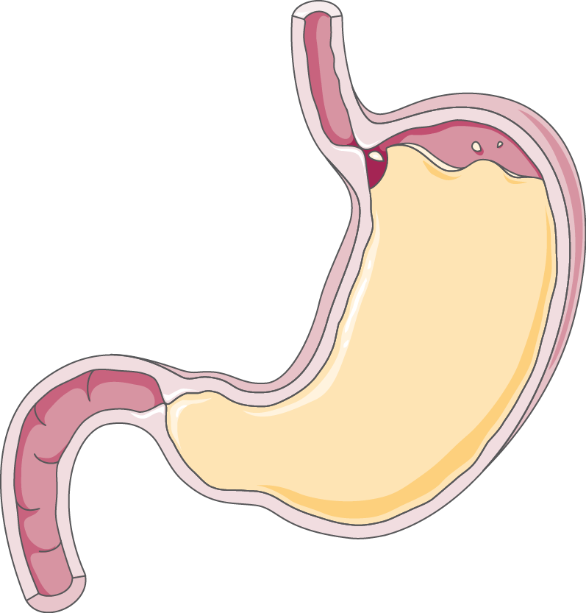
Evaluation
04

Slide 20
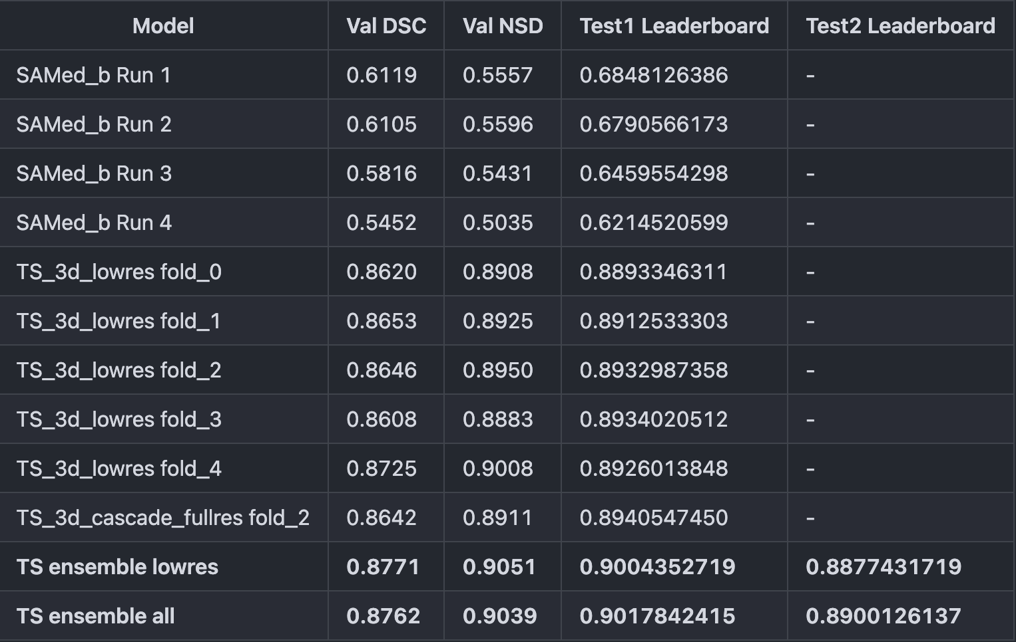
Results - Model Performance Overview
SAMed Models (LoRA-enhanced SAM)
Performance: Moderate across 4 runs
Validation DSC: 0.54 - 0.61
Validation NSD: 0.50 - 0.55
Test1 Leaderboard: 0.62 - 0.68
Best: Run 1 (DSC: 0.6119, NSD: 0.5557)
TotalSegmentator Models (TS_3d_lowres)
Performance: Higher and consistent across 5 folds
Validation DSC: 0.86 - 0.87
Validation NSD: 0.88 - 0.90
Test1 Leaderboard: 0.88 - 0.89
Best: Fold 4 (DSC: 0.8725, NSD: 0.9008)
Conclusion
TotalSegmentator significantly outperforms SAMed
~44% improvement in DSC, ~62.7% improvement in NSD
Notes:
There are three kinds of Methods.
Based on the evaluation results, …
Val DSC (Validation Dice Similarity Coefficient): Overlap between predicted segmentation and ground truth
Val NSD (Validation Normalized Surface Distance): How well the boundaries of the segmentation match
Range: 0 to 1 (higher is better)
DSC Interpretation: 1.0 = perfect overlap, 0.0 = no overlap, 0.8+ is typically considered good performance
Ensemble Combination (equal voting): Each model produces probability maps for all 12 organ classes -> Average probabilities from all models -> Convert to segmentation by argmax operation
NSD Why it matters:
- DSC can be high even if boundaries are slightly misaligned
- NSD is more sensitive to boundary accuracy, which is crucial for medical applications (e.g., surgery planning, tumor margins)
- Considers the distance between the predicted and true surfaces within a tolerance threshold
NSD Interpretation: Stricter than DSC for boundary precision; Critical for applications requiring accurate delineation

Slide 21
Results - Top Performers (Ensemble Methods)
TS ensemble lowres (5 models)
Val DSC: 0.877
Val NSD: 0.905
Test1 Leaderboard: 0.900
Test2 Leaderboard: 0.887
TS ensemble all (6 models) ⭐
Val DSC: 0.876
Val NSD: 0.903
Test1 Leaderboard: 0.901
Test2 Leaderboard: 0.890
+0.23% unseen data
Conclusion
Both ensemble methods show only marginal improvements over individual folds
TS ensemble all method delivers better performance on the actual test sets
Notes:
TS ensemble low-resolution method includes 5 TotalSegmentator low-resolution models from cross-validation; based one the results, its DSC and NSD are …
TS ensemble all method combines these 5 TotalSegmentator low-resolution models and 1 cascade full-resolution model; It uses a multiple-resolution diversity strategy
The performance of TS ensemble all method is almost the same as the TS ensemble low-resolution. Although it scores slightly lower on validation (-0.1%) but has stronger test performance.
In conclusion …
Referring to reasons for the higher performance:
First, the higher resolution processing captures finer details It also provides complementary predictions from different resolution strategies As a result, it performs better on unseen data

Slide 22
Discussion
Why did TotalSegmentator perform better than SAMed?
 | TotalSegmentator | SAMed
Training Data | Thousands of full-body CT scans All 12 target classes pretrained | Small mixed-modality dataset Only 8 classes
Architecture | nnU-Net: Fully convolutional Purpose-built for 3D medical imaging | 2D ViT adapted from SAM Designed for natural images
Processing | Native 3D pipeline + post-processing filters Better spatial consistency | 2D slice-by-slice Less coherent across slices
CT Opt. | Medical-grade preprocessing: Hounsfield unit clipping, Intensity normalization, Isotropic resampling | Generic RGB pipeline Not CT-optimized
Class Balancing | Auto-balances Focuses on small organs | Uniform sampling Miss small structures
Notes:
Referring to reasons, there are 5 aspects: The first one, Training Data
TotalSegmentator is pretrained on thousands of full-body CT scans with 12 organs, covering all target classes
SAMed uses a smaller mixed-modality dataset with only 8 pretrained classes
Architecture
TotalSegmentator built on nnU-Net, is a fully convolutional network tailored for 3D medical volumes.
SAMed, based on the 2D Vision Transformer (SAM) for natural images, performs poorly on volumetric data
Processing
TotalSegmentator uses a native 3D pipeline with enhanced spatial consistency and 3D post-processing
SAMed is based on 2D slice-by-slice and results less cohesive across slices
CT-Specific Optimization
TotalSegmentator uses a medical-grade preprocessing, including Hounsfield unit clipping, intensity normalization, and isotropic resampling
SAMed uses a general RGB-oriented pipeline, which is not tailored for CT.
Class Balancing
TotalSegmentator automatically balances class frequencies and emphasizes small organs
SAMed uses a uniform slice sampling, which might overlook small structures
Segmentator: 12 target classes(organs) pretrained + 1 background = 13 output channels
SAMed: 8 target classes pretrained + 4 classes (from scratch during the training) + 1 background = 13 output channels

Slide 23
Further Work
Pre-segmentation bbox cropping
SAMed
Explore targeted sampling for small organs
Fine-tune LoRA rank parameter
Consider 3D context integration
Total Segmentator
Examine the automated processing and tune hyperparameters
Use transfer learning and cross-validation with other data sets

